Slide 1
Research Report Writing
Pravin Kumar
Professor, Dept. of Mechanical Engineering
Delhi Technological University

Slide 2
CONVENTIONS OF ACADEMIC WRITING
Person and voice
• Written as objectively as possible
• Typically use third-person pronouns (appears less subjective)
Qualitative research is exception to this rule
• Active voice is more appropriate than passive voice
* Tense
• Typically written in past tense (study has already been conducted)
• Some sections (description of current situation or problem; recommendations) written in present tense
• Tentative vs. definitive statements
• State definitively—methodological aspects of study; results
• State tentatively—conclusions; implications

Slide 3
* Clarity
• Crucial aspect—should be written clearly enough for another person to read and to duplicate methodological steps
• Use few words, simple terminology (when feasible)
• Organize report in logical format; use headings and subheadings
• Consistency
• Be consistent throughout; use same acronyms, abbreviations, formatting
• Simplicity of language
• Reports should be written in simple, straightforward style
• Avoid overuse of adjectives, adverbs
• Keep your message short and simple

Slide 4
PRELIMINARY SECTION
Title page
Abstract
Candidate Declaration
Acknowledgement
Table of Content
List of Tables
List of figures
List of Abbreviation

Slide 5
Titles
Initial screening mechanism for those considering reading your work
Should clearly indicate what the study, report are about
Grab your readers’ attention

Slide 6
CHAPTER 1-INTRODUCTION
Introduction
1.1 Background of the study
1 .2 Problem Statement
1 .3 Purpose and objective of the study
1 .4 Research Questions
1.5 Definition of Terms
1 .6 Significant of the study
1 .7 Conclusion

Slide 7
CHAPTER 2-LITERATURE REVIEW
2.0 Introduction
2.1 Body of the literature
2.1 .1 General area of research
2.1.2 Underlying theory
2.1 .3 Variables used from previous literature
2.2 Theoretical Framework
2.3 Hypotheses
2.4 Conclusion

Slide 8
CHAPTER 3- RESEARCH METHODOLOGY
3.0 Introduction
3.1 Research Design
3.2 Variable and Measurement
3.3 Questionnaire design
3.4 Population and Sample
3.5 Scope of the study
3.6 Data analysis method
3.6.1 Goodness of data
3.6.2 Inferential analysis
3.7 Conclusion

Slide 9
CHAPTER 4- DATA ANALYSIS AND FINDINGS
4.1 Introduction
4.2 Goodness of Measure
4.2.1 Representativeness of data
4.2.2 Validity test
4.2.3 Reliability test
4.3 Inferential analysis
4.3.1 Descriptive analysis
4.3.2 Test of difference
4.3.3 Test of relationship
• Correlation analysis
• Hypothesis testing
4.4 Conclusion

Slide 10
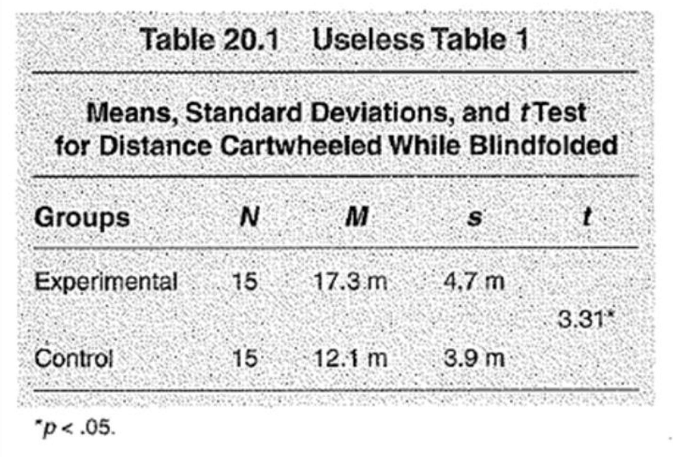
Useless table

Slide 11
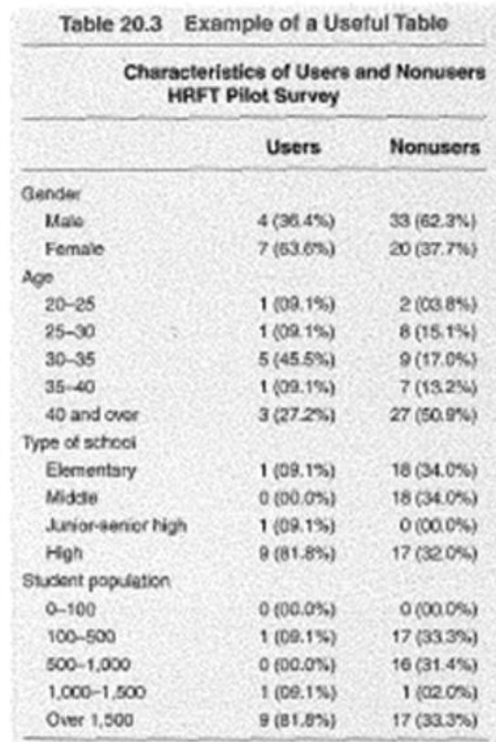
Useful table

Slide 12
Findings/analysis
Contains the findings in full (facts only from
Includes additional detail on the issue.
Provides financial/numerical information in text and tables, if appropriate.
Some reports integrate findings with analysis.
Others have a separate section for analysis

Slide 13
CHAPTER 5-DISCUSSION AND CONCLUSION
5.1 Recapitulation of major findings
5.2 Discussion
5.3 Implication
5.3.1 Theoretical Implication
5.3.2 Practical Implication
5.4 Limitation
5.5 Recommendation for future research
5.6 Conclusion

Slide 14
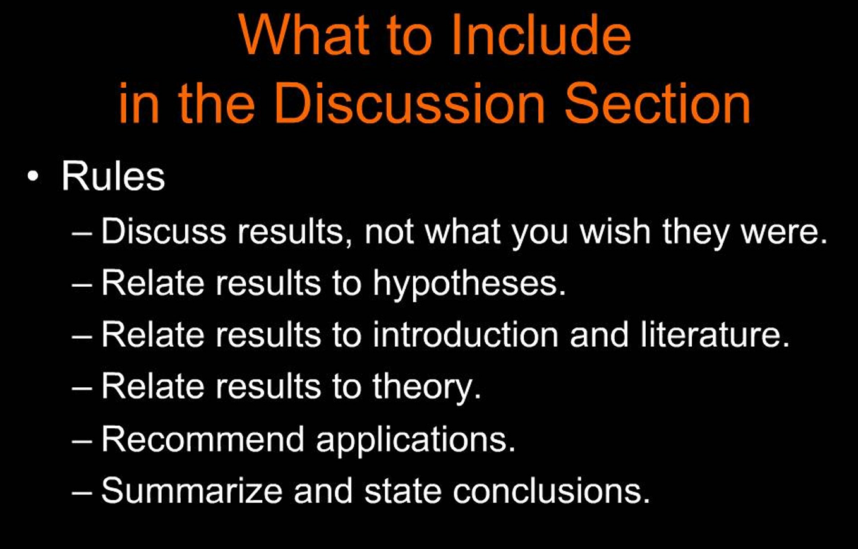

Slide 15
Conclusions
There statement conclusion of thesis a short summary of main issue/s.
May use dot points for ease of reading.
Use parallel grammar. (Start dot point with a verb in the same tense.)

Slide 16
Conclusions
There is a link between recommendations and findings,
Findings are factual and verifiable.
Conclusions are your own ideas that you deduce from the findings.
Recommendations are what you want done.

Slide 17
Recommendation(s)
Suggests possible action in the future.
Provides you with the opportunity to think of creative solutions, based on the findings and conclusions in the report.
Must not include any new information.
Should be given in order of importance (i.e. the most important should go first).
Often uses dot points.

Slide 18
BIBLIOGRAPHY AND
REFERENCES
MLA
Kumar, Pravin, Rajesh Kr Singh, and Vikas Kumar. "Managing supply chains for sustainable operations in the era of industry 4.0 and circular economy: Analysis of barriers." Resources, conservation and recycling 164 (2021): 105215.
APA
Kumar, P., Singh, R. K., & Kumar, V. (2021). Managing supply chains for sustainable operations in the era of industry 4.0 and circular economy: Analysis of barriers. Resources, conservation and recycling, 164, 105215.
Chicago
Kumar, Pravin, Rajesh Kr Singh, and Vikas Kumar. "Managing supply chains for sustainable operations in the era of industry 4.0 and circular economy: Analysis of barriers." Resources, conservation and recycling 164 (2021): 105215.
Harvard
Kumar, P., Singh, R.K. and Kumar, V., 2021. Managing supply chains for sustainable operations in the era of industry 4.0 and circular economy: Analysis of barriers. Resources, conservation and recycling, 164, p.105215.
Vancouver
Kumar P, Singh RK, Kumar V. Managing supply chains for sustainable operations in the era of industry 4.0 and circular economy: Analysis of barriers. Resources, conservation and recycling. 2021 Jan 1;164:105215.

Slide 19
APPENDICES
Derivation
Codes
SPSS Output

